Slide 1
Configuring Named Entity Extraction through Real-Time Exploitation of Linked Data
Pavlos Fafalios, Manolis Baritakis and Yannis Tzitzikas
fafalios@ics.forth.gr
Foundation for Research and Technology – Hellas (FORTH)
Institute of Computer Science (ICS)
Information Systems Laboratory (ISL)
University of Crete
Computer Science Department
Greece
Notes:
Hello, my name is Pavlos Fafalios. I am a 2nd year PhD student at University of Crete and member of the Information Systems Laboratory at FORTH-ICS.
This is a work in collaboration with Manolis Baritakis, a graduate student of University of Crete, and our supervisor Yannis Tzitzikas.

Slide 2
Outline
Introduction
Named entity extraction / Motivation / Contribution
The proposed approach
The configuration model
The system X-Link
Architecture / Functionality / Configurability
Evaluation
User study / Case study
Conclusion and Future Research
Notes:
At first, I will briefly describe what named entity extraction is, I will motivate the problem and state our contribution.
Then, I will detail the approach that we propose, specifically I will describe a model for configuring a NEE system.
I will also present X-Link, a Named Entity Extraction system that fully supports the proposed configuration model.
Finally, I will give you evaluation results, and I will conclude by discussing also the next steps of this research.

Slide 3
Named Entity Extraction
Named Entity Extraction (NEE) is the process of identifying entities in texts and linking them to related semantic resources
Useful in many applications:
Annotating documents, Question answering, Results post-processing, …
The Semantic Web realization highly depends on the availability of metadata (structured content in general) describing Web content
A NEE system can automate the extraction of structured data from Web content
A lot of information about named entities is already available as Linked Open Data (LOD)
The exploitation of LOD by a NEE system can bring wide coverage and fresh information
Notes:
Named Entity Extraction is the process of identifying entities such as Persons, Locations, etc. in texts and linking them to related semantic resources.
This process is useful in many applications such as for annotating documents, in question answering, in results post-processing.
The importance of NEE is justified by the fact that the semantic Web realization highly depends on the availability of metadata describing web content and a NEE system can help towards this direction by automating the extraction of structured data from Web content.
We should also stress that the Linked Open Data cloud contains plenty of information for many types of entities, so the exploitation of Linked Data by a Named Entity Extraction system can bring wide coverage and fresh information.

Slide 4
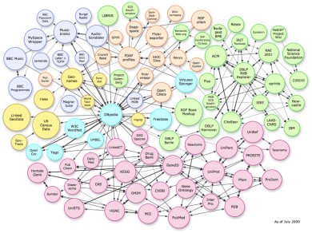
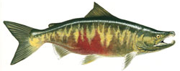
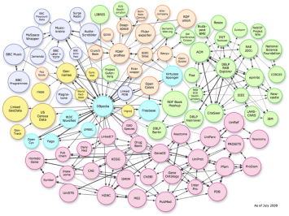
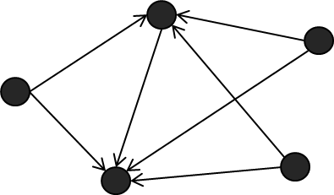
LOD-based Named Entity Extraction
named entity recognition
(using NLP/ML and/or Gazetteers)
Fish Species
chum salmon
coho salmon
atlantic Salmon
poacher
sockeye salmo
chinook salmon
entity linking
http://dbpedia.org/resource/Chum_salmon
kingdom: Animali
phylum: Chordata
class: Actinopterygii
order: Salmoniformes
binomial authority: J. Walbaum
entity enrichment
Notes:
Let’s now see the process, a Linked Data-based NEE system first applies named entity recognition in a document according to a configuration. Note here that named entity recognition can be performed using Natural Language Processing methods, machine learning techniques, or Gazetteers. In all cases, the result is a set of entity names. For example, here we consider that the system has been configured to identify names of fish species, so in this case the entities are fishes.
Then, the system tries to link an identified entity name with semantic resources in the LOD cloud, that is with one or more URIs. For instance, in this example, the entity name “chum salmon” has been matched with a resource from DBpedia Knowledge Base.
Finally, the system can retrieve additional information regarding a resource again by exploiting the LOD cloud. For instance, it can retrieve some properties, an image or other related entities.

Slide 5
Motivation (1/2)
There are many LOD-based tools that support NEE
DBpedia Spotlight, AlchemyAPI, OpenCalais, AIDA, Wikimeta, …
Configuring an existing NEE system for building domain specific applications is…challenging!
Time consuming and laborious even for persons with computer science background
requires many technical skills
Existing tools are mainly dedicated to one specific Knowledge Base which is indexed beforehand
thereby, they do not exploit the dynamic and distributed nature of LOD
Notes:
There are many tools that support Linked Data-based NEE like Dbpedia Spotlight, AlchemyAPI, OpenCalais, AIDA, etc. However, configuring one of these system for building a domain specific application is very time consuming and laborious even for persons with computer science background.
In addition, existing tools are mainly dedicated to a specific Knowledge Base which is indexed beforehand, and so they do not exploit the dynamic and distributed nature of LOD.

Slide 6
Motivation (2/2)
In existing NEE tools, the user (an admin or a developer) cannot easily:
define its own interesting types/categories of entities
update/extend an existing category with additional entities coming from a new Knowledge Base (KB)
Specify how to link the identified entities with semantic resources
Control how to enrich the identified entities, i.e. configure the properties that are useful for a particular application
e.g. retrieve images, or a description in a specific language
Inspect whether and how the identified entities are connected
not within the document but as entities in general
Notes:
Furthermore, in existing Named Entity Extraction systems, the user (who can be the administrator or the developer of the underlying application) cannot easily define their own interesting categories of entities (for example Greek names), or to update an existing category with additional entities coming from a new Knowledge Base.
The user also cannot specify how to link the identified entities with semantic resources.
For instance, consider that a new KB appears which contains plenty of information for a particular type of entities. It would be useful if one could somehow dynamically “plug” the new KB in a NEE system, enabling the linkage of the identified entities with resources from the new KB.
Moreover, the user cannot control how to enrich the identified entities, that is to configure the properties that are useful for a particular application, or inspect whether and how the identified entities are connected not within the document but as entities in general.

Slide 7
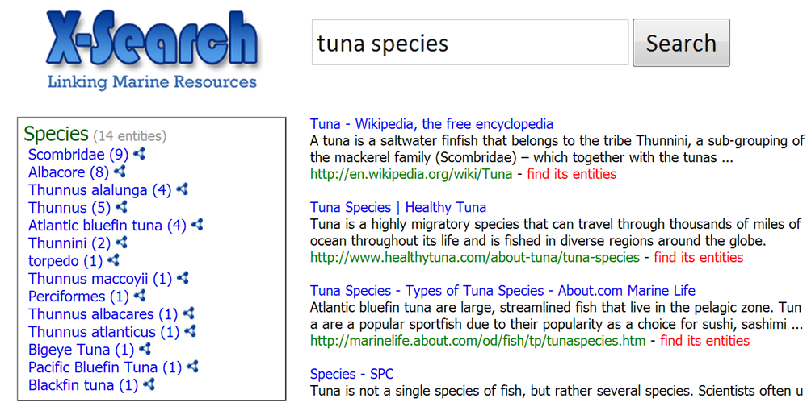
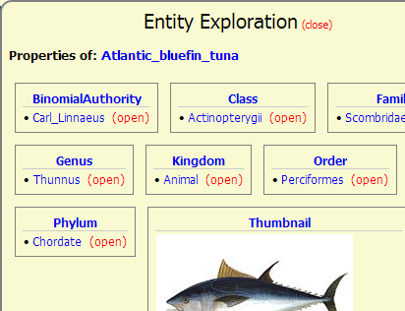
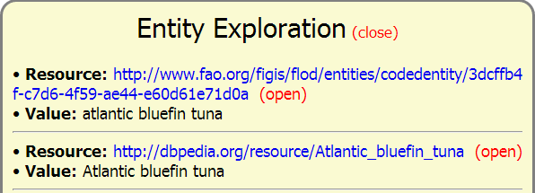
Motivating Example (1/2)
Application: Semantic post-processing of search results
NAMED ENTITY RECOGNITION (detect entities in the search results)
ENTITY
LINKING
ENTITY
ENRICHMENT
Notes:
Let’s see an application example that motivates our focus on configurability. X-Search is a meta-search system which has been configured for the marine domain and is currently used in the iMarine FP7 project. It receives a keyword-based query, sends the query to one or more sources and retrieves the results. For giving users an overview of the search space and allowing them to explore the results in a faceted way, X-Search applies entity mining in the results in order to identify and present to the users several types of entities like fish species. This is the Named Entity Recognition process.
The user can now restrict the search space to a small set of results containing information about a particular fish species.
The user can also on-demand and at real-time inspect semantic resources that match a fish name (this is the entity linking process) and can browse into the properties of a resource (this is the entity enrichment process).

Slide 8
Motivating Example (2/2)
Each community of users has different needs
X-Search should support different configurations
The needs of a community constantly change
We would like to be able to dynamically change the configuration (at any time, without requiring to redeploy the system)
The LOD constantly grows/changes
X-Search should be aware of the “fresh” information
Notes:
However, each community of users has different needs, which in our scenario means that X-Search should support different configuration.
For instance, scientists in an organization may want to also inspect other categories of entities in the search results, apart from Fish Species, for example Water Areas and Countries.
In addition, different communities of users may want to link and enrich the identified species with resources from different sources. For instance, one may want images from DBpedia, others with scientific papers that describe the genome of the species.
Moreover, and since the needs of a community constantly change, we would like to be able to dynamically change the configuration at any time without requiring to redeploy the system.
Finally, and since the LOD constantly grows and changes, X-Search should be aware of the fresh information.

Slide 9
Contribution
We will see:
A generic model for configuring (dynamically) a LOD-based NEE system
which can be exploited by existing NEE systems
X-Link, a fully configurable NEE tool that supports the proposed model
and…
The results of a task-based user study
The results of a case study
Lessons learned, limitations, how to cope with the limitations
Notes:
So, in the following slides we will se a generic model which allows the dynamic configuration of a NEE system. The key point is that this model can be also exploited by existing entity mining systems.
In the sequel, we will see X-Link, a fully configurable NEE tool that we have designed and implemented that supports the proposed model.
Then, I will also present the results of a task-based user study and of a case study that demonstrate the usability and the feasibility of the proposed approach, and finally we will see the lessons learned, limitations and some thoughts of how to cope with the limitations.

Slide 10
Outline
Introduction
Named entity extraction / Motivation / Contribution
The proposed approach
The configuration model
The system X-Link
Architecture / Functionality / Configurability / Applications
Evaluation
User study / Case study
Conclusion and Future Research
Notes:
No, we will see a model for configuring a Named Entity Extraction system.

Slide 11
Configuration Model
Notes:
This is a UML class diagram of the proposed configuration model.
Each category of entities has a name and can be associated with one or more Knowledge Base Mirrors.
A KBM specifies how to query an external Knowledge Base and holds the URL of a SPARQL endpoint.
A KBM is associated with four kinds of elements: (a) Resource Classes, (b) SPARQL Queries, (c) SPARQL Template Queries for Entity Linking, and (d) SPARQL Template Queries for Entity Enrichment.
A resource class can be used for specifying the entity names of interest by providing their RDF Class in the corresponding KB.
A SPARQL query has exactly the same objective, but instead of specifying an RDF class, a SPARQL query is provided.
A SPARQL LINKING template query allows specifying how entity names correspond to entity URIs, by providing a SPARQL query that can be answered by the Endpoint.
And finally, a SPARQL ENRICHING template query allows specifying what extra information in the form of RDF triples should be fetched for each entity URI, by providing a SPARQL query that can be answered by the Endpoint.

Slide 12
Example of the Configuration Model
SELECT DISTINCT str(?label) WHERE {
?uri rdf:type <http://dbpedia.org/ontology/Fish> .
?uri rdfs:label ?label FILTER(lang(?label)='en')
}
DBpedia Mirror
SPECIFICATION OF THE ENTITY NAMES
Fish Species
http://dbpedia.org/sparql
SELECT DISTINCT ?uri WHERE {
?uri rdf:type <http://dbpedia.org/ontology/Fish> .
?uri rdfs:label ?label FILTER(regex(str(?label), '[ENTITY]', 'i'))
}
FAO FLOD Mirror
http://www.fao.org.figis/flod/endpoint
LINKING TEMPLATE QUERY
Country
DBpedia Mirror_2
SELECT DISTINCT ?propertyName ?propertyValue
WHERE {
<[URI]> ?propertyName ?propertyValue
}
http://dbpedia.org/sparql
ENRICHING TEMPLATE QUERY
FactForge Mirror
http://factforge.net/sparql
Notes:
To make it clear, let’s now see an instantiation of the model.
Consider that the NEE system supports two categories of entities, Fish Species and Country.
We can associate the category Fish Species with two Knowledge Base Mirrors, one that corresponds to Dbpedia Knowledge Base and one that corresponds to FAO Fisheries Linked Open Data. For each one, we know its SPARQL endpoint.
Now, for DBpedia, we can set a SPARQL query for specifying the entity names of interest. This query can also be used for updating the entity names of this category, for example in case a new species is identified.
For entity linking, DBpedia’s mirror can be associated with a template query that tries to find resources that match a fish name.
Finally, we can also set a template query for enriching a fish name, which specifies the information that should be fetched from DBpedia for describing information about a fish species.
Likewise, we can set resource classes, SPARQL queries and SPARQL template queries for all KBMs related to the supported categories.

Slide 13
Specification of the entity names of interest - Example
http://dbpedia.org/sparql
SELECT DISTINCT str(?label) WHERE {
?uri rdf:type <http://dbpedia.org/ontology/Fish> .
?uri rdfs:label ?label FILTER(lang(?label)='en')
}
Acanthicus
Acanthurus
Acanthurus achilles
Acanthurus albipectoralis
Acanthurus auranticavus
Acanthurus chronixis
….
Notes:
Let’s now analyze the aforementioned SPARQL queries.
This query requests all resources of type Fish and for each resource we want to retrieve its labels in English.
The result of running this query to DBpedia’s SPARQL endpoint is a list of fish names in the English language.
In this way, by exploiting the expressive power of SPARQL we can create a complex SPARQL query that describes a particular set of entities which have some common characteristics.

Slide 14
Linking Template Query – Example
http://dbpedia.org/sparql
SELECT DISTINCT ?uri WHERE {
?uri rdf:type <http://dbpedia.org/ontology/Fish> .
?uri rdfs:label ?label FILTER(regex(str(?label), '[ENTITY]', 'i'))
}
Notes:
Here is the template query for linking a fish name with semantic resources, that is with URIs.
Notice that the template query contains the character sequence ENTITY inside brackets which at query time is replaced by the entity’s name which in our example is a fish name.

Slide 15
Linking Template Query – Example
http://dbpedia.org/sparql
For the entity name “chum salmon”:
SELECT DISTINCT ?uri WHERE {
?uri rdf:type <http://dbpedia.org/ontology/Fish> .
?uri rdfs:label ?label FILTER(regex(str(?label), ‘chum salmon', 'i'))
}
http://dbpedia.org/resource/Chum_salmon
Notes:
For instance, for the entity name “chum salmon”, the query requests for resources of RDF class dbpedia.org/ontology/Fish, whose label contains the string “chum salmon”, ignoring case.
By running this query at DBpedia’s SPARQL endpoint, the result is this URI.

Slide 16
Enriching Template Query – Example
http://dbpedia.org/sparql
SELECT DISTINCT ?propertyName ?propertyValue
WHERE {
<[URI]> ?propertyName ?propertyValue
}
Notes:
Likewise, this template query allows specifying what extra information should be fetched for an entity URI.
Here the template parameter is the character sequence URI inside brackets, which at query time is replaced by a URI.
In this example, the query retrieves all the outgoing properties of a resource.

Slide 17
Enriching Template Query – Example
http://dbpedia.org/sparql
For the entity URI “http://dbpedia.org/resource/Chum_salmon”:
SELECT DISTINCT ?predicate ?object
WHERE {
<http://dbpedia.org/resource/Chum_salmon> ?predicate ?object
}
http://dbpedia.org/ontology/binomialAuthority http://dbpedia.org/resource/Johann_Julius_Walbaum
http://dbpedia.org/ontology/class http://dbpedia.org/resource/Actinopterygii
http://dbpedia.org/ontology/family http://dbpedia.org/resource/Salmonidae
http://dbpedia.org/ontology/genus http://dbpedia.org/resource/Oncorhynchus
http://dbpedia.org/ontology/kingdom http://dbpedia.org/resource/Animal
http://dbpedia.org/ontology/order http://dbpedia.org/resource/Salmonidae
http://dbpedia.org/ontology/phylum http://dbpedia.org/resource/Chordate
... … … … ... … … …
Notes:
For example, for the URI that corresponds to the fish Chum salmon, this is the query that is submitted and these are some of the properties that are returned by DBpedia.
So, one can specify to retrieve any desired type of properties, or even exploit the federated features of SPARQL 1.1 for combining and retrieving information from more that one sources.

Slide 18
Inferring the connectivity of the identified entities
Graph(doc,r)
Oncorhynchus
Vertebrae
67-75
161976
Chum
Salmon
genus
ID
Chinook
Salmon
ID
genus
161977
genus
Vertebrae
family
family
Coho
Salmon
59-71
calcium mg
Salmonidae
family
Vertebrae
61-69
ID
11
161977
Notes:
By collecting the RDF triples that correspond to a set of entities, we can form an RDF graph from which we can infer whether and how these entity URIs are connected.
For instance, in this example we see that the three entities that are in blue are of the same genus and family.
Of course one could extend the query in order to obtain triples that can be reached up to a certain radius in the RDF graph.
In general, for a document ‘doc’, or a set of documents in general, we can create a graph within a radius “r” which shows how the identified entities are connected.

Slide 19
Outline
Introduction
Named entity extraction / Motivation / Contribution
The proposed approach
The configuration model
The system X-Link
Architecture / Functionality / Configurability / Applications
Evaluation
User study / Case study
Conclusion and Future Research
Notes:
Let’s now see a system that we have implemented and which supports the proposed configuration model.

Slide 20
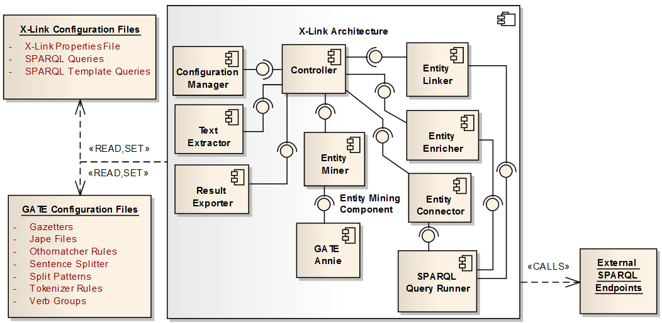
Architecture
Notes:
This is the architecture of X-Link. X-Link is currently based on the GATE Annie Information Extraction system and supports both gazetteers and NLP functions.
X-Link extends Gate Annie in order to be able to add a new supported category of entities and update one using gazetteers. This gives us the opportunity to adapt its functionality according to our needs, making X-Link configurable and extendible.
Another important component is the Configuration Manager which is responsible for reading and changing the configuration.
The components Entity Linker, Entity Enricher and Entity Connector are responsible for retrieving the corresponding semantic information by querying external SPARQL Endpoints using the SPARQL Query Runner component.

Slide 21
Functionality – Input / Output
Supported file types
Plain text
HTML
PDF
.doc, .docx
.ppt, .pptx
XML-based
Output
Currently, in XML and CSV
Soon in RDF (exploiting the Open Annotation standard)
Notes:
X-Link supports the analysis of plain text files, html pages, pdf files, Microsoft Word and PowerPoint files, as well as XML-based files.
Currently, X-Link exports the results in XML and CSV, however we are working on offering the output in RDF exploiting the Open Annotation standard.

Slide 22
Functionality – Entity Mining and Entity Linking
Entity Mining
Using Gate ANNIE
Currently, no disambiguation is applied (when using gazetteers)
If an entity name exists in two supported categories, then this entity is returned twice, one for each category.
Fuzzy matching: identification of an entity that does not match exactly an entity in a category’s gazetteer
Using configurable edit (Levenshtein) distance that depends on entity name’s length
Entity Linking
For a detected entity name, X-Link returns the matching URIs according to the specified template queries
Notes:
As regards the entity mining process, as I said before, X-Link uses Gate Annie.
We should stress here that currently no entity disambiguation is applied, meaning that if an entity name exists in two supported categories, then this entity is returned twice, one for each category. This allows the underlying application to disambiguate the entities after the entity mining process, by exploiting for example context information.
X-Link can also identify entities that do not match exactly an entity in a category using Edit Distance. The allowed edit distance value is configurable and depends on the length of the matching entity.
As regards Entity Linking, for a detected entity X-Link return the matching URIs according to the specified template queries.

Slide 23
Functionality – Entity Enrichment
Entity Enrichment
Retrieve RDF triples
According to the specified template queries, or
Select one of some predefined (common) types of properties:
i) outgoing, ii) incoming, iii) both outgoing and incoming, iv) outgoing in a language, v) both outgoing in a language and incoming
Inspect the connectivity of the entity URIs within a radius
Retrieve and show the triples that connect the entity URIs
Notes:
As regards entity enrichment, X-Link can either retrieve the triples described by the specified template queries, or retrieve one of some common types of properties, for example all the outgoing properties, the incoming properties, etc.
In addition, X-Link can inspect the connectivity of the entity URIs within a given radius.
Specifically, it has a function that retrieves the triples that connect the entity URIs.

Slide 24
Configurability
File-based configuration
x-link.properties
1 xlink.categories.supported = Fish;Country;Water_Area;Disease;Drug;Protein;Chemical_Substance
2 xlink.categories.active = Fish;Country;Water_Area
3 xlink.categories.Fish.kbms = dbpedia_fish
4 xlink.categories.Fish.kbms.dbpedia_fish.endpoint = http://dbpedia.org/sparql
5 xlink.categories.Fish.kbms.dbpedia_fish.resourceclasses = http://dbpedia.org/ontology/Fish; http://umbel.org/umbel/rc/Fish
6 xlink.categories.Fish.kbms.dbpedia_fish.templatequeries.linking = C:/tmpls/dbpFishLinking.sparql
7 xlink.categories.Fish.kbms.dbpedia_fish.templatequeries.linking.parameter = [ENTITY]
8 xlink.categories.Fish.kbms.dbpedia_fish.templatequeries.enriching = C:/tmpls/dbpFishEnrich.sparql
9 xlink.categories.Fish.kbms.dbpedia_fish.templatequeries.enriching.parameter = [URI]
10 xlink.connect.radius = 1
11 xlink.fuzzy = true
12 xlink.fuzzy.value = 0.2
Notes:
As regards configurability, X-Link fully supports the proposed configuration model described before.
On system startup, it reads a configuration from a properties file. This is an example of the properties file.
This file contains information about the supported categories, the KBMs, the template queries, etc.

Slide 25
Configurability
Configuration API
X-Link can be dynamically configured (even while a corresponding service is running)
Supported functions:
Add a new category (using a resource class or a SPARQL query)
Update an existing category (using a resource class or a SPARQL query)
Remove a category
Change the displayed name of a category
Set/change the KBMs of a category
Set/change the resource classes, the SPARQL queries and the SPARQL template queries of a KBM
Set/change the active categories
Set/change the value of radius “r”
Set/change if fuzzy matching is allowed and the allowed edit distance percentage
Notes:
An important feature of X-Link is that it can be dynamically configured through its API.
This allows its configuration even while a corresponding service is running.
Several functions are supported.
Each function changes accordingly the properties file and also updates several files in Gate Annie. For example, when a new category is created, the corresponding gazetteer file is created and loaded in Gate Annie and the name of the categories is added in the set of supported categories in the properties file.

Slide 26
Portability
The configuration files can be easily exchanged
Their size is relatively small
E.g., for supporting 4 categories related to the marine domain, the configuration files have size less than 5MB
The size mainly depends on the number of supported categories and on the number of the named entities in each category
X-Link does not store any semantic information (e.g. URIs or RDF triples)
The entity linking and entity enrichment processes are performed at real-time
Notes:
Another important feature is that the configuration files can be easily exchanged since their size is relatively small.
For example, consider that I configure X-Link and sends the configuration files to a friend of me. My friend can set X-link to use my configuration files and now he can enjoy exactly the same configuration.
Note that X-Link does not store any semantic information. The entity linking and entity enrichment processes are performed at real-time.

Slide 27
Applications
http://62.217.127.118/x-search
X-Search uses the X-Link library in two different contexts:
In the marine domain (in the context of the iMarine Project)
The MarineTLO-based warehouse is exploited for entity linking and enrichment
In patent search (in the context of the PerFedPat project)
Tailored for medical biology
Notes:
X-Link is currently used by the X-Search system that I describe in the introduction in two different contexts: in the marine domain and in Patent Search.
In both contexts, the administrator of the system can configure X-Link through a configuration page.
In iMarine, X-Link has been configured to identify Fish Species, Water Areas, Countries and Regional Fisheries Bodies, while the Knowledge Base that is exploited is the MarineTLO-based Warehouse, a warehouse which integrates information coming from multiple marine-related sources.

Slide 28
Outline
Introduction
Named entity extraction / Motivation / Contribution
The proposed approach
The configuration model
The system X-Link
Architecture / Functionality / Configurability / Applications
Evaluation
User study / Case study
Conclusion and Future Research
Notes:
Now we will see the results of a task-based user study and of a case study

Slide 29
Task-based User Study
Purpose:
Test the usability of the proposed approach
Identify usability problems
X-Link was deployed as a Web application configured for the marine domain
Identification of Fish Species in a text or Web page
Entity Linking, Entity Enrichment
The administrator can change the configuration through an administration page
Target User:
An administrator or a developer who wants to use X-Link for
building and dynamically configuring an application
Notes:
The purpose of the user study is to test the usability of the proposed approach and mainly to identify usability problems that will allow us to improve the system.
We deployed X-Link as a Web application configured for the marine domain, that can identify fish species in a given text or web page, while the administrator can change the configuration through an administration page.
Note that the target user of this evaluation is an administrator or a developer who wants to use X-Link for building and dynamically configuring an application.

Slide 30
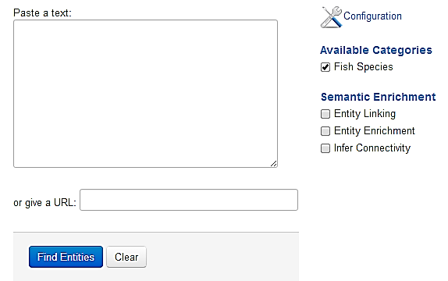
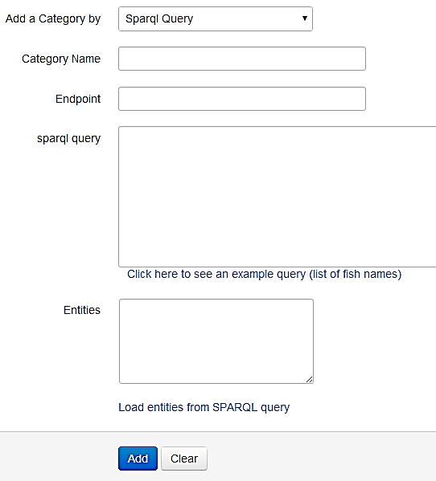
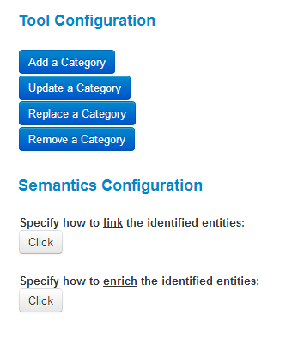
Task-based User Study – The Web Application
Notes:
This is a screenshot of the Web application.
By clicking the configuration button, the user can see the configuration options.
And this is the form for adding a new category of entities.

Slide 31
Task-based User Study – Setting
11 subjects (23-34 years old) with computer science background, and basic knowledge of Linked Data and SPARQL
5-minute demonstration of the application and its functionality
Tasks:
(T1) Add a new category of entities
(T2) Update a category
(T3) Specify how to link the identified entities of a category
(T4) Specify how to enrich the entity URIs of a category
(T5) Inspect the connectivity of the entity URIs (for r=1)
The endpoint and the required RDF classes/properties are given
Since our objective was not to evaluate the ability of the user to find related semantic information
We recorded:
Whether the subjects succeeded to complete each task
The time to successfully accomplish each task
Notes:
11 persons with computer science background and a basic knowledge of Linked Data and SPARQL were participated.
Note that according to several studies, 10 persons are enough for revealing sever usability problems.
We demonstrated in 5 minutes the application and its functionality and then we asked them to perform 5 tasks, specifically to add a new category of entities, to update a category, to specify how to link the identified entities, to specify how to enrich the identified entities and finally to inspect the connectivity of the entity URIs.
We recoded whether the subjects succeeded to complete each task as well as the time to successfully accomplish each task.

Slide 32
Task-based User Study – Scenario
Consider that you are the administrator of an application that can identify Fish names (currently supporting only the English language) in Web pages.
You have been asked to perform some changes. Specifically, by exploiting DBpedia, the application must also identify European Countries (T1)
as well as fish names in Spanish (T2)
(because the application will be used mainly by Spaniards).
Also, the identified fishes must be linked with resources from DBpedia (T3) and must be enriched with all their outgoing properties (T4). Finally, in order to test that the system has been properly configured, perform entity mining in the Spanish version of Salmon's Wikipedia page and then inspect the connectivity of the identified entities (T5).
Notes:
The tasks are based on the following scenario: Consider that you are the administrator of a marine application that can identify and annotate Fish Names in Web pages. Currently, only English fish names can be identified.
You have been asked to perform some changes. By exploiting DBpedia, the application must also identify European countries as well as fish names in Spanish because the application will be used mainly by Spaniards. Also, the identified fish names must be linked with resources from DBpedia and must be enriched with their outgoing properties. Finally, for testing that the system has been properly configured, perform entity mining in the Spanish version of Salmon’s Wikipedia page and then inspect the connectivity of the identified entities.

Slide 33
Task-based User Study – Results
Average time for completing successfully each task
Success rate for each task (results from 11 users)
Fully configuration in < 6 min
T1: Add the category “European Countries”
T2: Update the category Fish with fish names in Spanish
T3: Link the identified Fishes with resources from DBpedia
T4: Enrich the identified Fishes with their outgoing properties
T5: Inspect the connectivity of the identified entities
Notes:
Here are the results. We notice that all participants managed to add the new category, to update the category and to inspect the connectivity of the identified entities. However, two persons failed to set how to link the fish species and one person failed to set how to enrich them.
The difficulty behind these two tasks is the comprehension of the SPARQL template query and the role of the template parameter inside the query. This was also made evident by the responses in a questionnaire that we will see later on.
As regards the time, we notice that the more time consuming task was to set how to link the identified entities which required about 2 minutes which is a predictable result because this task was the first that required the user to construct a SPARQL template query. However, it is very important that in average, the participants managed to totally configure the system according to the scenario in less than 6 minutes.

Slide 34
Task-based User Study – Questionnaire
(Q0) How easy was to configure the system according to the scenario?
(Q1) How easy was to add the new category of entities?
(Q2) How easy was to update the existing category?
(Q3) How easy was to specify how to link the identified entities?
(Q4) How easy was to specify how to enrich the identified entities?
(Q5) How easy was to inspect the connectivity of the identified entities?
(Q6) What was difficult for you during the execution of the scenario?
(Q7) How familiar are you with SPARQL?
Notes:
At the end, we also asked participants to complete a questionnaire, answering:
How easy was to configure the system according to the scenario, how easy was to complete each one of the 5 tasks, what was difficult for them during the execution of the scenario, and how familiar they are with SPARQL.

Slide 35
Task-based User Study – Answers
(Q0-Q5) Evaluation of the difficulty in performing the scenario (results from 11 users)
(Q6) What was difficult for you during the execution of the scenario:
Difficulty in understanding the notion of the SPARLQ template queries
Suggestion to provide a user-friendly interface for constructing them
(Q7) How familiar are you with SPARQL:
1 (I don’t know SPARQL): 0%
2 18%
3 36%
4 36%
5 (I am expert in SPARQL) 9%
Q0: How easy was to configure the system according to the scenario?
Q1: How easy was to add the new category of entities?
Q2: How easy was to update the existing category?
Q3: How easy was to specify how to link the identified entities?
Q4: How easy was to specify how to enrich the identified entities?
Q5: How easy was to inspect the connectivity of the identified entities?
Notes:
Here are the results regarding the difficulty in performing the scenario.
We notice that none of the participants considered one of the tasks difficult, very difficult or impossible.
About 80% of the participants found the overall configuration an easy task while about 20% found it very easy.
As regards the tasks 3 and 4 which according to the success rates ware the most difficult tasks, we notice that about half of the participants found it an easy task.
Regarding the difficulties during the execution of the scenario, the main difficulty was in understanding the notion of the SPARQL template queries, while some suggested to provide a user friendly interface for construction them. We believe that if we had dedicated more time in explaining the notion of the template queries by giving more examples, probably all participants would successfully complete all tasks. Finally, as regards their familiarity with SPARQL, we notice that about half of the participants were not very experienced with SPARQL , however most of them managed to configure the system.

Slide 36
Case Study: Querying online DBpedia at real-time
Purpose: Test the feasibility of the entire approach
We measured the time for:
creating a new category
linking an identified entity with semantic resources
enriching an entity URI
inferring the connectivity of the entity URIs
We repeated the experiments about 20 times and here we report the average values
Data used in the experiments:
http://www.ics.forth.gr/isl/X-Link/files/exper_data.zip
The experiments were carried out using an ordinary computer with processor Inter Core i7@3.4Ghz CPU, 8GB RAM, Win7 64bit. Implementation in Java 1.7.
Notes:
We also performed a case study for testing the feasibility of the entire approach.
We used DBpedia as the underlying Knowledge Base and measure the time for creating a new category, the time for linking an entity with semantic resources, the time for enriching an entity URI and the time for inferring the connectivity of the entity URIs. For improving the accuracy of the results, and since we queried an online KB, we repeated the experiments about 20 times and here we report the average values.
This case study can also be considered an evaluation of DBpedia, which is an online knowledge base, since we run many queries at DBpedia’s SPARQL endpoint.
The data used in the experimental evaluation are accessible through this link. The experiments were carried out using an ordinary computer with an Intel Core i7 processor, 8 GB RAM, Windows 7 64bit, while the implementation was in Java.

Slide 37
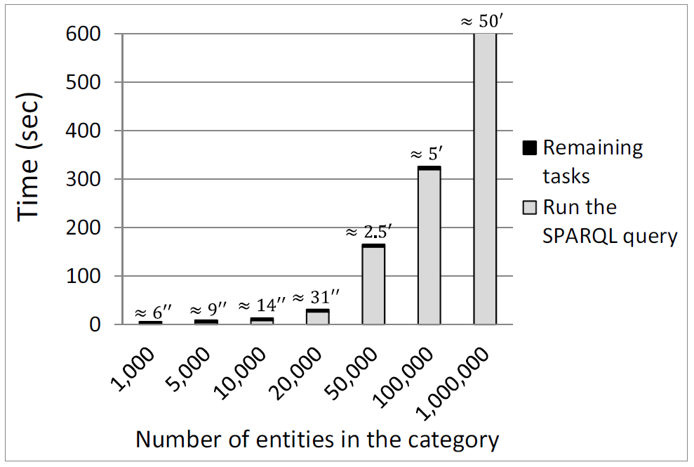
Case Study: Time for adding a new category
We used 7 sets of DBpedia resource classes. Each set has 5 different resource classes containing a particular number of entities, i.e. totally 35 different resource classes were used.
Notes:
The time for adding a new category of entities highly depends on the number of entities in this category. For this reason we used 7 sets of DBpedia resource classes, each one corresponding to different number of instances. We measure the time for running the SPARQL query and the time for reading the answer and creating the category in X-Link.
As expected the time consuming task is the execution of the SPARQL query, since we query DBpedia at real time.
We notice that for resource classes with less than 10,000 entities, the time is less than 20 seconds, while for resource classes with about 100,000 entities the time is about 5 minutes. A limitation regarding DBpedia’s SPARQL endpoint is that it does not return more than 50,000 results at once, so we had to run multiple queries for resource classes with more than 50,000 entities using SPARQL’s LIMIT and OFFSET operators. For this reason, adding a category with 1 million entities costs about 50 minutes. However, note that this task is performed once in a pre-processing step, or every time we want to update the entities of the corresponding category, so it does not affect the efficiency of the underlying application.

Slide 38
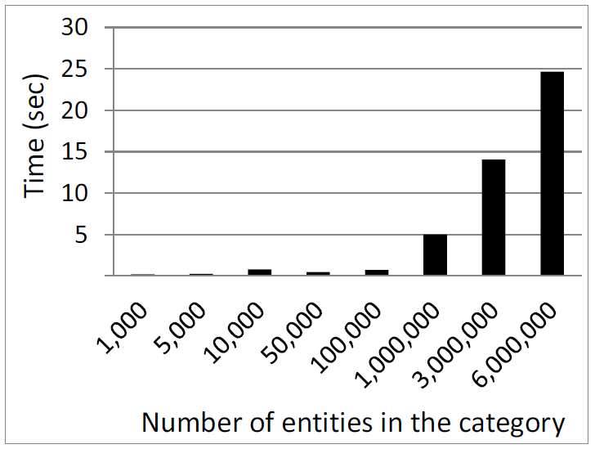
Case Study: Time for linking an identified entity
We used 8 sets of DBpedia resource classes. Each set has 5 different resource classes containing a particular number of entities, i.e. totally 40 different resource classes were used.
For each resource class, we randomly selected 10 labels of entities belonging to that class.
Notes:
The time for linking an entity with semantic resources again highly depends on the total number of entities belonging to the corresponding category. We notice that for entities belonging to categories with up to 100,000 entities the average time is less than 1 second while for entities in categories with up to 1 million entities, the linking time is about 5 seconds. In addition, for linking an entity belonging to a category with 6 million entities, the time is about 25 seconds.

Slide 39
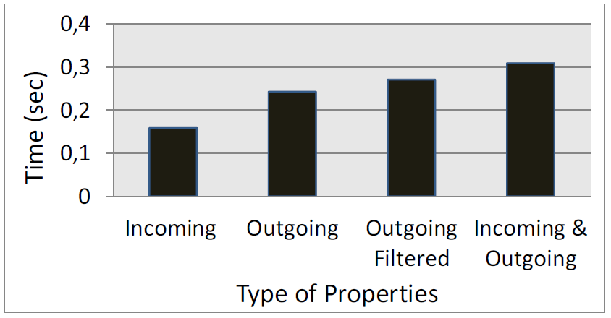
Case Study: Time for enriching an entity URI
We randomly selected 160 URIs from DBpedia
Notes:
The time for enriching an entity URI mainly depends on the type of properties that we want to retrieve. We run indicative experiments for 4 common types of properties and as expected that time is very low, less than half a second for all types of properties.

Slide 40
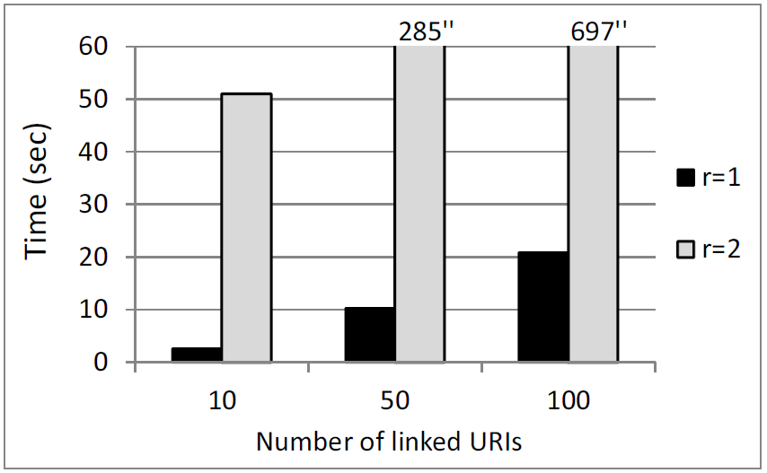
Case Study: Time for inspecting the connectivity
We randomly selected URIs of the same resource class from DBpedia and we repeated the experiments for 5 different resource classes.
Notes:
Finally, the time for inspecting the connectivity of the entity URIs obviously depends on the number of linked URIs for which we wan to inspect the connectivity. We run indicative experiments for different number of randomly selected URIs belonging to the same class, and for radius equal to one and radius equal to two.
We notice that for radius equal to one, the time is proportional to the number of URIs, and it requires about 10 seconds for every 50 URIs. However, for r=2 the task is very time consuming and is increased exponential to the number of URIs. This is a predictable result since each URI may contain many related URIs.
We have to stress also that this is often acceptable in professional search and the user may desire to pay the cost.

Slide 41
Lessons Learned – Reliability and Scalability
Existing publicly available Knowledge Bases are not reliable
They mainly serve demonstration purposes
Their efficiency and availability change over time
They do not serve multiple concurrent requests
If an entity belongs to a category with millions of entities then the linking time can be high
The same is true in case the underlying application requires to retrieve semantic information for numerous entities at once
Caching/Indexing is a solution, but with the cost of loosing the freshness of the results
In a real application:
The underlying KBs may not be publicly available
A dedicated Warehouse can be constructed that will serve the application
Distributed infrastructure
Notes:
The major bottleneck is that the existing publicly available online KBs like DBpedia are not optimized for efficiency and are not reliable.
We have noticed that their efficiency and availability change over time and also they do not serve multiple concurrent requests.
In addition, we saw that if an entity belongs to a category with millions of entities then the linking time can be high and the same is true in case the underlying application requires to retrieve semantic information for numerous entities at once.
In such cases, adopting a caching mechanism or indexing a part of the underlying KB is a solution, but with the cost of loosing the freshness of the results.
Of course, in a real-application the underlying KBs may not be publicly available, or a dedicated warehouse can be constructed that will serve our application. In addition, the KBs or the Warehouse may be distributed in many servers, so the system can apply a load balancing technique for serving the requests.

Slide 42
Outline
Introduction
Named entity extraction / Motivation / Contribution
The proposed approach
The configuration model
The system X-Link
Architecture / Functionality / Configurability / Applications
Evaluation
User study / Case study
Conclusion and Future Research

Slide 43
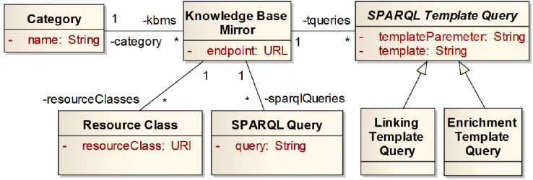
Conclusion
A generic model for configuring (dynamically) a LOD-based NEE system
X-Link
A LOD-based, fully configurable, NEE tool that supports the proposed model
By adopting the proposed approach one can configure a NEE system within a few minutes
The exploitation of LOD can be supported at query-time
The major bottleneck is the reliability and performance of online SPARQL endpoints
We expect this limitation to get overcome in the near future
In the meanwhile, we can use caching/indexing/dedicated warehouses/distributed infrastructure
Notes:
To sum up, we saw a generic model for configuring dynamically a Linked Data-based NEE system, and a system called X-Link, that adopts this model.
We also saw that by adopting the proposed approach one can configure a NEE system within a few minutes, and also that the exploitation of LOD can be supported at query-time, of course according to the application context.
The major bottleneck is the reliability and performance of the online SPARQL endpoints, however we hope that tis limitation to get overcome in the near future as such technologies mature and get used in applications.

Slide 44
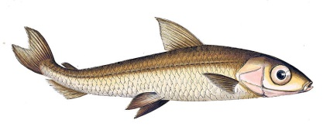
Future Research
It would be beneficial for the community if every NEE system supported the proposed configuration model
We work on defining an RDF vocabulary with explicit semantics
We evaluate approaches for entity disambiguation that are appropriate in our setting
We elaborate on methods for ranking the matching URIs in case they are numerous
Argentina,
the country
Argentina,
the fish genus
Notes:
We strongly believe that it would be beneficial for the community if every NEE system supported the proposed configuration model, and for this reason we work on defining an RDF vocabulary with explicit semantics.
We also work on methods for ranking the matching URIs and for entity disambiguation that are appropriate for our setting.

Slide 45
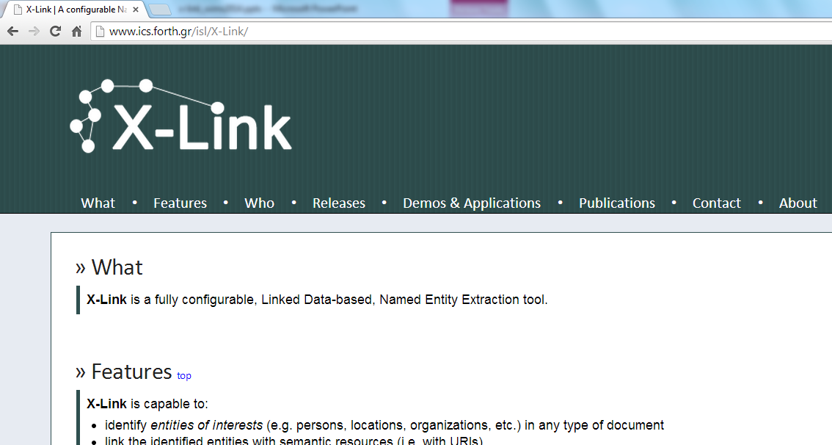
Thank you!
http://www.ics.forth.gr/isl/X-Link/

