Slide 1
Delivering the multiagent technology to end-users through the web
D. Mitrović¹, M. Ivanović¹, C. Bădică²
¹University of Novi Sad, Serbia
²University of Craiova, Romania

Slide 2
Agenda
Introduction
Overview of Radigost
Case-studies
Conclusions

Slide 3
HTML5
HTML5 standard has brought significant benefits to both software developers and end-users
Software developers benefit from the cross-platform support as the same code can be re-used in many different environments
End-users are given the access to online applications in a variety of ways, without the significant loss of functionalities
Radigost: interoperable, purely web-based multiagent platform, built using modern HTML5 technologies

Slide 4
HTML5-related technologies in Radigost
JavaScript: lingua franca of the web
Web workers: native threads in JavaScript
Provide agents with its own thread of execution
Include an efficient messaging infrastructure
WebSockets: full-duplex communications channels over a single TCP connection
Provide standard way for the push communication

Slide 5
Agenda
Introduction
Overview of Radigost
Case-studies
Conclusions

Slide 6
Radigost
Radigost is a purely web-based multiagent platform, built using modern HTML5 technologies
Radigost agents and parts of the system itself are implemented in JavaScript and executed inside the client's web browser
The system is standards-compliant and interoperable, capable of interacting with third-party multiagent solutions
Its runtime performance is comparable to that of a desktop-based multiagent implementation

Slide 7
Main functionalities of Radigost
Radigost provides the necessary infrastructure for the deployment, execution and interaction of its agents
Its core functionalities include:
Agent life-cycle management
A communication infrastructure
A yellow-pages service
Additionally, Radigost incorporates several advanced features:
Interoperability sub-system
Support for agent state persistence

Slide 8
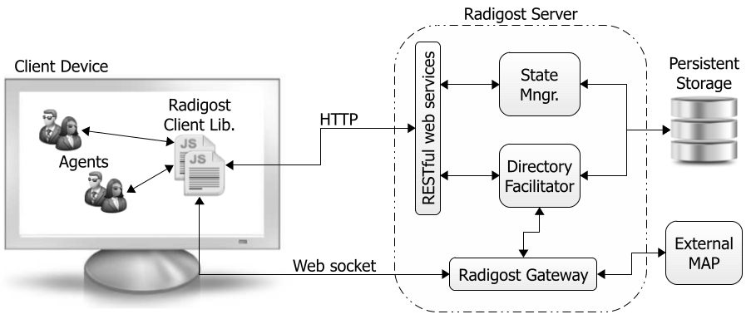
Architecture overview – core components
Offers server-side persistent storage for agent state
Provides a set of API s through which most of the system’s functionality is exposed
Yellow-pages service - maintains list of registered agents
Notes:
Radigost incorporates several core components, distributed between client devices and a dedicated server. The set of components includes: the client library, Directory Facilitator, State Manager, and Gateway.
The client library provides a set of API s through which most of the system’s functionality is exposed. For example, an agent uses the client library to construct and send messages to other agents.
Directory Facilitator acts as a yellow-pages service. It maintains a complete list of registered agents, including their descriptions and capabilities.
State Manager offers server-side persistent storage for agent state. When the user closes the agent’s web page, the agent’s state is automatically stored on the server. Later, once the web page is re-opened, the state is automatically injected into the agent and it continues the execution.
Gateway is a server-side component that increases the system’s interoperability. It enables Radigost agents to interact with agents hosted in external, third-party multiagent platforms, such as JADE and XJAF.

Slide 9
Agenda
Introduction
Overview of Radigost
Case-studies
Conclusions

Slide 10
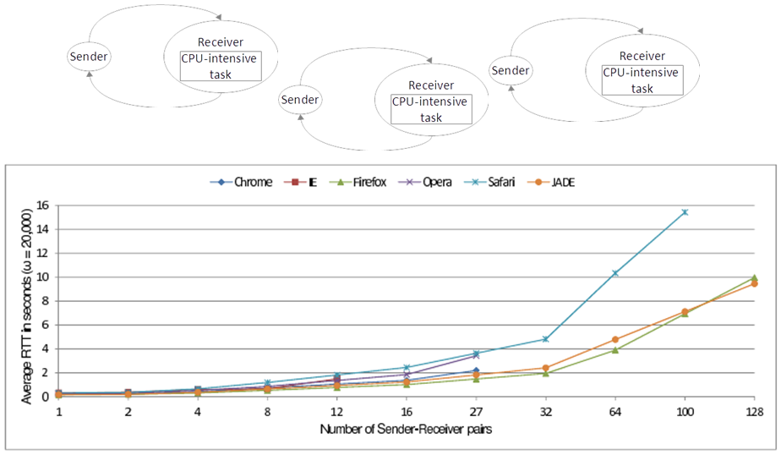
Performance evaluation
Generates a random, 64-character long message
Notes:
The evaluation is based on two types of agents: Sender and Receiver. The Sender agent generates a random, 64-character long message and sends it to its accompanying Receiver. Once it gets the message, Receiver performs a CPU -intensive, time-consuming computation, and then sends back a reply. To determine the system’s scaling factor, the number of Sender-Receiver pairs is increased over time and the message round-trip time is measured at each step.

Slide 11
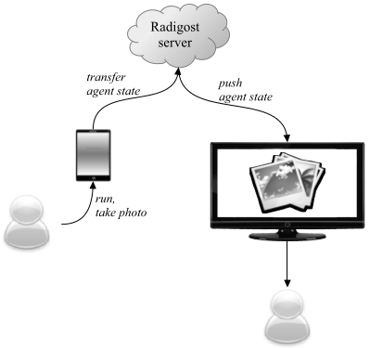
Employing agent mobility
The second case-study includes a mobile Radigost agent
The user loads the web page on its smartphone device, takes a photo, and chooses a target device (e.g. Smart TV)
The mobile agent then takes the photo, moves to the target device, and displays the photo there
The case-study demonstrates the benefits of using Radigost and capabilities of the agent
technology

Slide 12
Agenda
Introduction
Overview of Radigost
Case-studies
Conclusions

Slide 13
Conclusions
HTML5 has transformed the web into a serious application development platform
Multiagent systems based on Radigost have several advantages over classic desktop applications:
No prior installation or configuration steps
Updates are available instantly to all end-users
Support on many hardware and software platforms, including desktop computers, smartphone and tablet devices, and Smart TVs
Future work on the platform will be focused on a number of areas: security issues, support for reasoning agents, etc.

